Slide 1


Signal Strength:
Philanthropy and the Future of Public Media
Current Challenges and the Path Forward

Slide 2
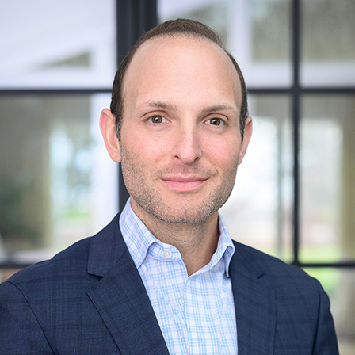


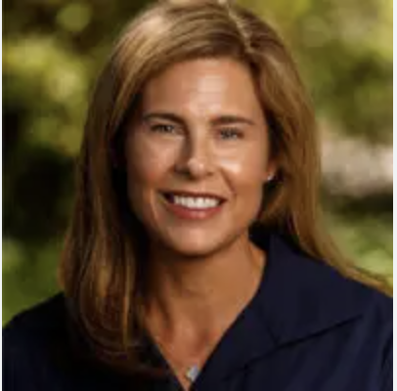
Presenters
DOUG LONDON
MONICA VILLAMIZAR
ANNIE MADONIA
KATHERINE LAWSON
Managing Director,
CCS Fundraising
Filmmaker/Reporter
Chief Advancement Officer
The Lenfest Institute for Journalism
Vice President of Philanthropy
Rocky Mountain Public Media

Slide 3
Arts & Culture
Philanthropy and Fundraising:
The Broader Signal

Slide 4
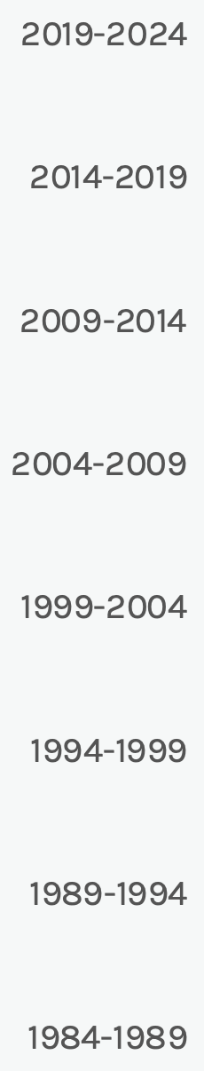
Giving to Arts, Culture, and Humanities
Portion of Total Giving in 2024​
Change in Giving Percentages 1984-2024
(IN BILLIONS OF DOLLARS | ALL FIGURES ARE ROUNDED)
4%
Arts, culture, & humanities
$25.13
4%
To individuals
$23.59
3%
Environment/animals
$21.57
6%
International Affairs
$35.54
23%
Religion
$146.54
10%
Health
$60.51
14%
Human Services
$91.15
11%
Public-society benefit
$66.84
11%
Gifts to grantmaking
foundations**
$71.92
14%
Education
$88.32
*Total includes unallocated giving, defined as the difference between giving by source and recipient categories. Unallocated giving totaled -$38.60 billion in 2024.
**Estimates developed by the Indiana University Lilly Family School of Philanthropy using data provided by Candid.
Giving USA Foundation: Giving USA 2025: The Annual Report on Philanthropy for the Year 2024. (2025)

Slide 5
Arts and Culture Organizations Saw Overall Donor Success
In 2024, Arts & Culture organizations outperformed the overall nonprofit sector by achieving higher rates of revenue growth, donor acquisition, and donor retention. This suggested that these organizations experienced stronger fundraising momentum and were more successful at engaging and keeping new supporters compared to other sectors.
Arts & Culture 2024
Arts & Culture 2023
All Sectors in 2024
58% saw a revenue increase
65% acquired new donors
56% retained over half of new donors
61% saw a revenue increase
64% acquired new donors
53% retained over half of new donors
62% saw a revenue increase
53% acquired new donors
49% retained over half of new donors
CCS Philanthropy Pulse

Slide 6
Public Media:
Strengthening the Signal

Slide 7
Public Media Funding
Over 1,500 locally owned and operated public media stations in the US and territories.
Most funding comes from individual contributions
Largest single source of funding is federal support distributed by the Corporation for Public Broadcasting (CPB).
  Receives an annual federal appropriation of $535 million (~0.01% of the federal budget)
  More than 70% of CPB funds go directly to local stations.
Other funding includes state/local governments, educational institutions, foundations, businesses, and private colleges/universities.
Sample PBS Funding
Corporation for Public Broadcasting. CPB FAQ. (2025),
Public Media Alliance. Statement: "PMA: Senate must reject CPB funding cuts." (June 13, 2025).
PBS. "How do federal $$$ get to your local station?" (July 6, 2020)

Slide 8
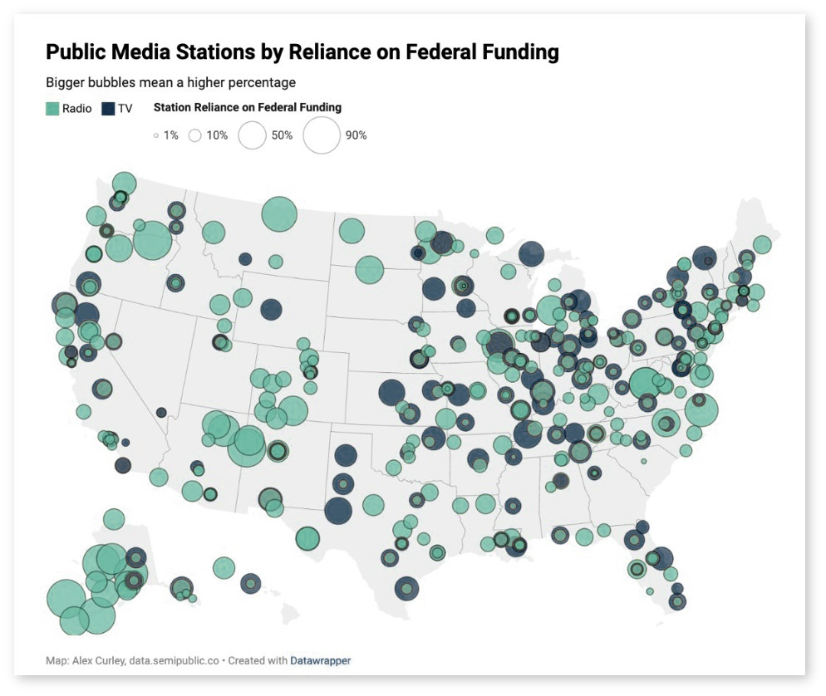
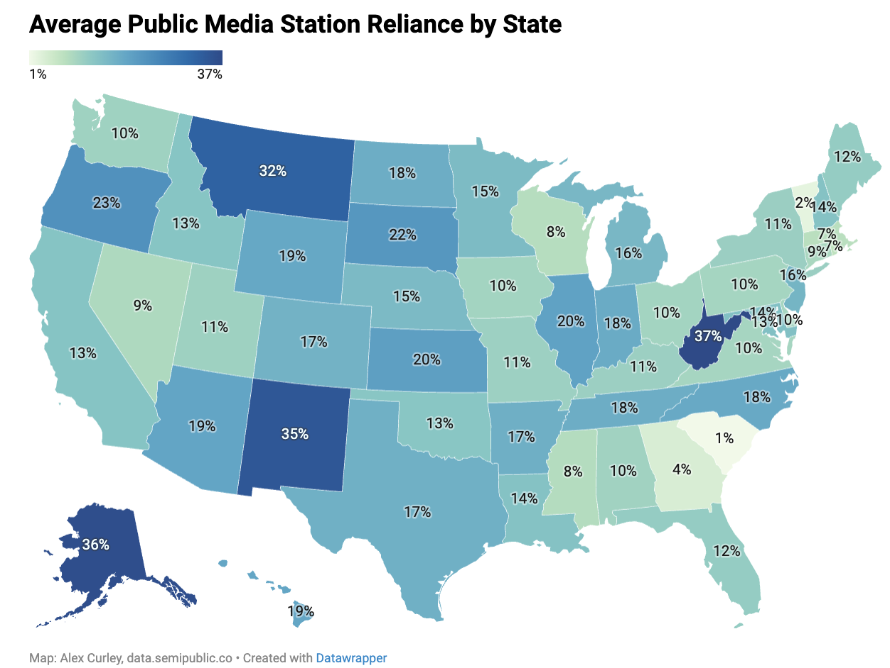
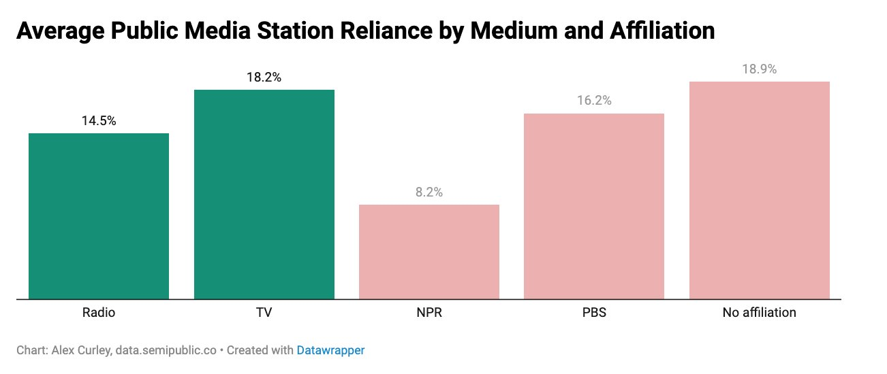
Why Federal Dollars Matter: Reliance on Federal Funding
Current. "Here’s how much public media relies on federal funding, and what could happen next." (April 24, 2025).

Slide 9
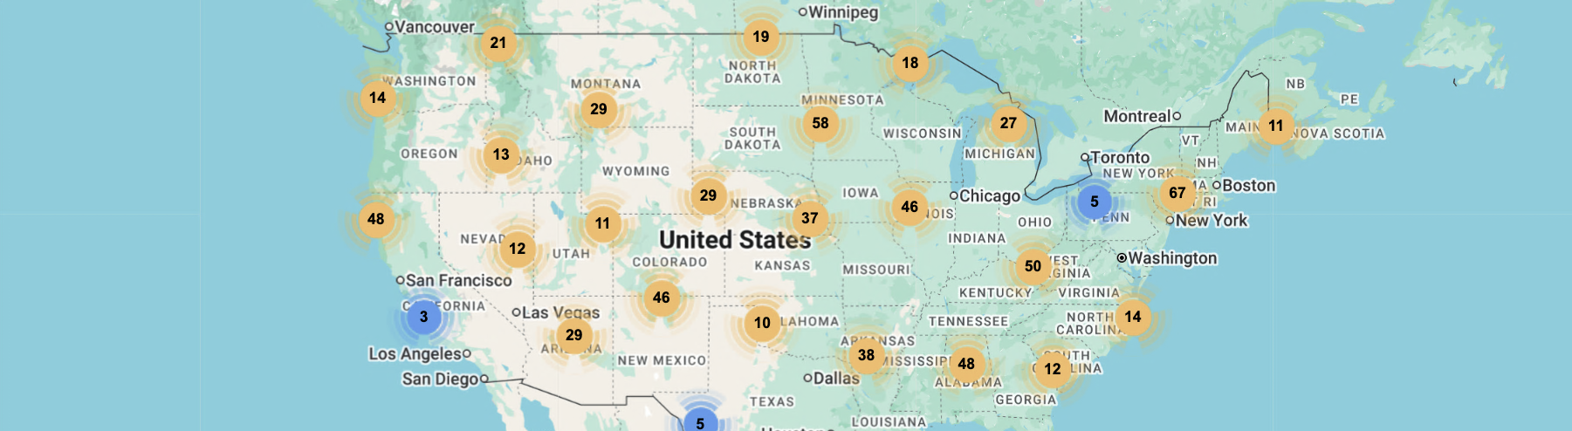
01
Rural stations are significantly more reliant on CPB support than urban ones. CPB grants make up 17% of rural station revenue on average (vs. 9% for urban), and some rural stations —particularly those on Native American reservations — depend on CPB for more than 50% of their revenue.
02
Geographic and political disparities are also visible, as Republican-leaning states averaged more CPB funding per capita ($1.62) than Democratic-leaning states ($1.26), a pattern tied to population density, infrastructure costs, and the rural footprint of public media.
03
States with smaller populations receive disproportionatelay more CPB funding per person. Those under 3 million residents averaged over twice the per-capita funding of larger states. Alaska stands out at $11.86 per person, nearly 8 times the national average.
Curley, Alex. “How Much Does Public Media Cost Your State?” Current. (March 20, 2025).
Corporation for Public Broadcasting. “Support for Rural Stations.” CPB.org. (2024).

Slide 10
CCS Fundraising
10
History of Federal Funding Threats
1970s
(Richard Nixon): Opposed funding, vetoed bills, PBS coverage of Watergate intensified opposition.
1994
(Bill Clinton): Newt Gingrich pledged to eliminate funding in “Contract with America,” but no success.
2017-2020
(Donald Trump 1st term): Proposed eliminating NPR/PBS funding, no Congressional action.
1969
(Richard Nixon): Proposed cutting CPB funding from $20 million to $10 million. Mr. Rogers appeared before Senate Subcommittee on Communications and is credited with securing full funding.
1980s-2000s
(Ronald Reagan, George H.W. Bush, Bill Clinton, George W. Bush): Attempts to reduce funding blocked by Congress citing educational value (e.g., Sesame Street). Several attempts to cut funding rejected by House Republican coalitions.
2011
(Barack Obama): House passed bill to cut NPR funding after undercover video, blocked by Senate.
2023
(Joe Biden): House Republicans introduced H.R.1632 (No Partisan Radio and Partisan Broadcasting Services Act) to prohibit funding for NPR/PBS; stalled in committee.

Slide 11
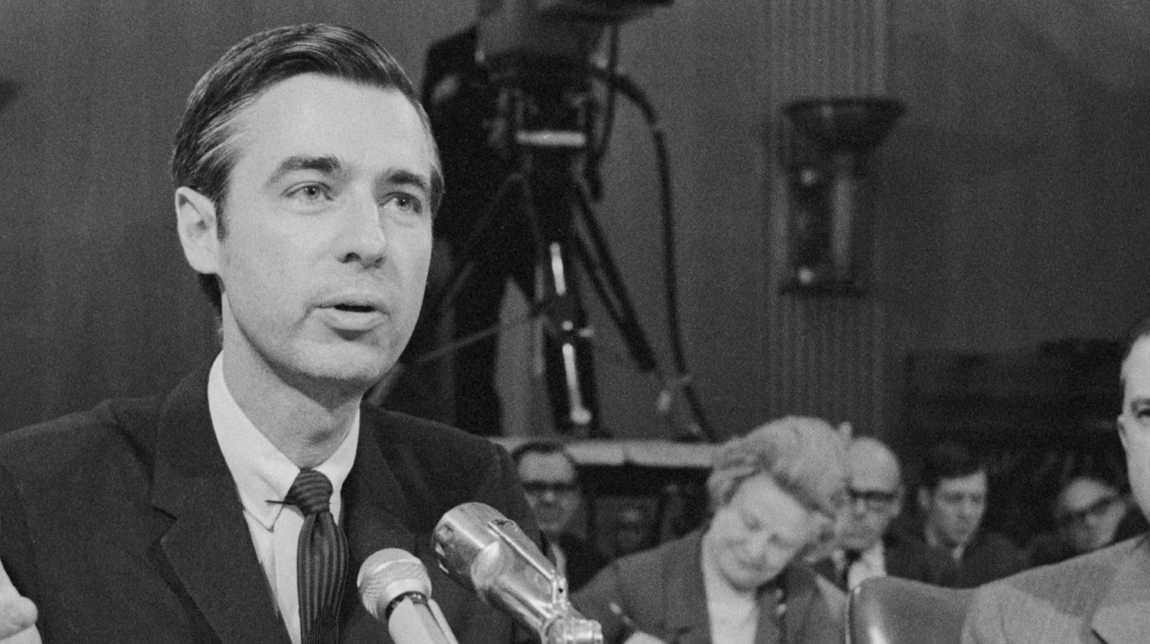

“
We made a hundred programs for EEN, the Eastern Educational Network, and then when the money ran out, people in Boston and Pittsburgh and Chicago all came to the fore and said we've got to have more of this neighborhood expression of care.
—Fred Rogers, May 1, 1969

Slide 12
The Current Threat to Federal Funding
May 1, 2025
Executive Order “Ending Taxpayer Subsidization of Biased Media”
Directs CPB to halt funds to NPR & PBS, claiming federal funding for media that “present a one-sided, partisan, or ideologically driven narrative” violates the public trust.
Fact Sheet “President Donald J. Trump Ends the Taxpayer Subsidization of Biased Media”
Claims NPR and PBS “have consistently demonstrated a clear bias in their reporting” and cites specific editorial decisions as evidence. Concludes that “the era of taxpayer-funded media bias is over.”
H.R.4: Rescissions Act of 2025
House passes a rescission bill that includes stripping $1.1 billion in public media funding over two years. This bill is part of a larger $9.4 billion package aimed at reversing previously appropriated government funding.
Trump’s “No Support” Warning:
Donald Trump warns he will not back Republican Senators who oppose defunding NPR and PBS ahead of the pivotal Senate vote.
Senate Vote
The Senate approved a revised rescission package, including $1.1 billion in cuts to public media funding.
House Vote
Because the Senate amended H.R. 4., the House voted again and passed the Senate's version of the bill.
June 12, 2025
July 10, 2025
July 17, 2025
July 18, 2025

Slide 13
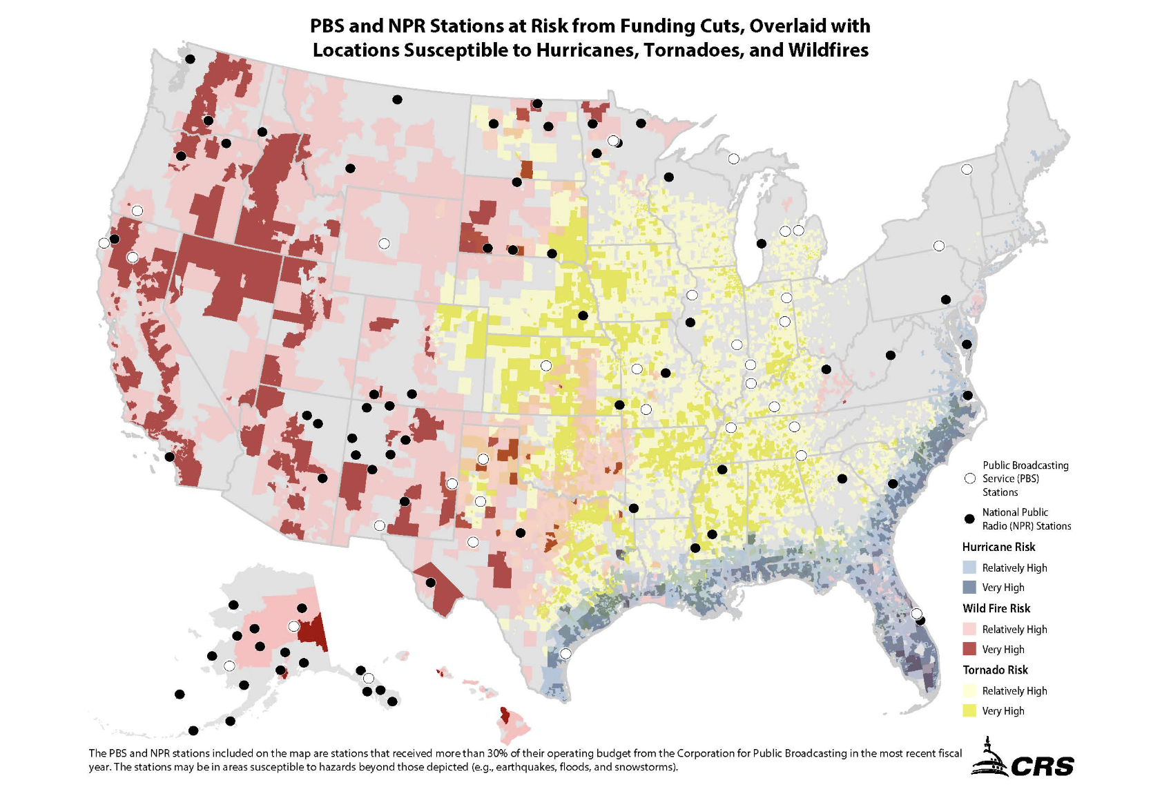
The Risk to Public Safety
Federal funding cuts could leave millions without access to life-saving emergency information—especially in rural areas.
13 million Americans could lose access to emergency alerts.
Rural stations are often the only local news and safety source.
Severe weather threats + station closures = dangerous information gaps.
U.S. Senate Commerce, Science, & Transportation. "Cantwell Report Highlights Vital Role PBS and NPR Play in Warning Public During Weather Emergencies." (July 9, 2025)
Sample PBS Funding

Slide 14
Reactions to Current Events
Lawsuits
  NPR and three Colorado public radio stations sued the Trump administration over the May executive order, arguing it was unconstitutional retaliation violating the First Amendment. Rocky Mountain PBS has joined the action.
  PBS sued the Trump administration days later, calling the move unconstitutional “viewpoint discrimination.”
“The President’s blatantly unlawful Executive Order, issued in the middle of the night, threatens our ability to serve the American public with educational programming, as we have for the past 50-plus years. We are currently exploring all options to allow PBS to continue to serve our member stations and all Americans." — Paula Kerger, President and CEO, PBS (May 2025)
“NPR has a First Amendment right to be free from government attempts to control private speech as well as from retaliation aimed at punishing and chilling protected speech." — NPR CEO Katherine Maher (May 2025)
“Amid a wider onslaught on public media in the US, including against the country’s international media services and the independence of the CPB, it is essential that domestic public broadcasters defend themselves against such egregious efforts to defund independent public service media." — Public Media Alliance (June 2025)
“Cutting this funding will not meaningfully reduce the deficit, but it will dismantle a trusted source of information for millions of Americans.” — Reps. Dan Goldman and Mark Amodei (June 2025)
“The letter of the day is 'C'. How appropriate because this bill is cruel, and it cuts children's programs all across the country.” — House Minority Leader Hakeem Jeffries, holding an Elmo doll (June 2025)
NPR. "NPR and Colorado public radio stations sue Trump White House." (May 27, 2025)
PBS News. "PBS suing Trump administration over defunding, three days after NPR filed similar case.." (May 30, 2025)
NPR. "House votes to kill funding for public media." (June 12, 2025).
PBS. "Statement from Paula Kerger, President and CEO, PBS. (May 2, 2025).
NPR. "NPR and Katherine Maher, CEO of NPR Statement" (May 27, 2025)
PMA. "PMA extends support to US public media." (June 3, 2025)

Slide 15

“
Despite the extraordinary efforts of millions of Americans who called, wrote, and petitioned Congress to preserve federal funding for CPB, we now face the difficult reality of closing our operations.
—Patricia Harrison, President and CEO, Corporation for Public Broadcasting

Slide 16
In the News — as of August 4, 2025
National
Corporation for Public Broadcasting Addresses Operations Following Loss of Federal Funding
Where Congress’s Cuts Threaten Access to PBS and NPR
Donations to NPR and PBS Stations Surge After Funding Cuts
New York
New York Public Media Will Lose At Least $57 Million in Federal Funds After Congressional Cuts
North Country PBS Stations Plan Big Changes to Deal With Federal Funding Cuts
Can a startup mentality help WXXI? New Chief Content Officer Julio Sáenz thinks so
Pennsylvania
Federal cuts strain Pittsburgh public media
WQED lays off 19 employees following federal funding cuts for public media
WITF Faces Uncertain Future as Congress Cuts Federal Funding for Public Media
Maine
Maine Public ‘will still be here,’ says president, despite federal funding loss
South Dakota
South Dakota Public Broadcasting Responds to Federal Funding Cuts
Missouri
KCUR rallies local support as federal funding cuts loom
Florida
Federal and state funding cuts hit PBS and NPR in Florida
Alabama
Alabama Public Television may drop NPR programming after federal funding cuts
Georgia
WABE and GPB Turn to Listeners After Federal Funding Cuts
Tennessee
Nashville Public Radio raises over $400K following Congress funding cut
West Virginia
Community radio stations are collateral damage as Congress cuts NPR funding
California
California’s NPR and PBS stations will cut staff and programs after funding slashed
Texas
El Paso's public media stations brace for impact as federal funding is cut
Michigan
Cuts to public broadcasting to impact local stations
WKAR GM addresses Corp. for Public Broadcasting closure
WGVU faces cuts following slashed public media funds
Wisconsin
Wisconsin public broadcasting set to lose $6M annually from federal cuts
Ohio
As federal cuts finalized, state lawmakers in Ohio also gave cuts to public broadcasting

Slide 17
Expanding the Signal:
A Panel Discussion

Slide 18
Sources
CDP. State of Fundraising: Q1 2025. Accessed July 14, 2025. https://static1.squarespace.com/static/5c41db0cb98a787328b67a44/t/68387db055296057c39e0642/1748532658192/PMBA_Q1+2025+State+of+Fundraising.pdf.
CCS Fundraising. 2025 CCS Philanthropy Pulse. 2025. Accessed July 14, 2025. https://www.ccsfundraising.com/insights/ccs-philanthropy-pulse/.
Congress.gov. H.R.1632 – NPR and PBS Act. Accessed July 14, 2025. https://www.congress.gov/bill/118th-congress/house-bill/1632.
Corporation for Public Broadcasting. CPB FAQ. Accessed July 14, 2025. https://cpb.org/faq#.
Corporation for Public Broadcating. CPB Support for Rural Stations. Accessed July 17, 2025. https://cpb.org/aboutpb/rural
Curley, Alex. "Here’s how much public media relies on federal funding, and what could happen next." Current. Published April 24, 2025. Accessed July 14, 2025. https://current.org/2025/04/heres-how-much-public-media-relies-on-federal-funding-and-what-could-happen-next/.
Curley, Alex. "The United States of Public Media.” Current. Published March 20, 2025. Accessed July 17, 2025. https://current.org/2025/03/the-united-states-of-public-media/
Folkenflik, David. “NPR and Colorado public radio stations sue Trump White House.” NPR. Updated May 27, 2025. Accessed July 14, 2025. https://www.npr.org/2025/05/27/nx-s1-5413094/npr-public-radio-lawsuit-trump-funding-ban.
Fox, Lauren. “White House formally sends its DOGE spending cuts request to Congress.” CNN. Updated June 3, 2025. Accessed July 14, 2025. https://www.cnn.com/2025/06/03/politics/doge-cuts-rescissions-package-trump.
Freking, Kevin, and Mary Clare Jalonick. “Congress Approves Trump’s $9 Billion Cut to Public Broadcasting and Foreign Aid.” Associated Press. Published July 18, 2025. Accessed July 18, 2025. https://apnews.com/article/pbs-npr-budget-cuts-trump-republicans-b0044285659ab708e23eb2dc2f3eabfa
Giving USA Foundation. Giving USA 2025: The Annual Report on Philanthropy for the Year 2024. 2025. Accessed July 14, 2025.
Hagey, Kreach. “Defunding NPR? It’s not that easy.” Politico. Published October 23, 2010. Accessed July 14, 2025. https://www.politico.com/story/2010/10/defunding-npr-its-not-that-easy-044056.
Johnson, Ted. “Donald Trump Threatens To Withhold Support For Lawmakers Who Vote Against Effort To Defund PBS, NPR And Public Media.” Deadline. Published July 10, 2025. Accessed July 14, 2025. https://deadline.com/2025/07/donald-trump-threats-to-withhold-support-for-lawmakers-who-vote-against-effort-to-defund-pbs-npr-and-public-media-1236454700/.

Slide 19
Sources (continued)
NPR. “NPR and Katherine Maher, CEO of NPR Statement.” Published May 27, 2025. Accessed July 14, 2025. https://www.npr.org/2025/05/27/g-s1-69017/npr-and-katherine-maher-ceo-of-npr-statement.
PBS News. “PBS suing Trump administration over defunding, three days after NPR filed similar case.” PBS. Published May 30, 2025. Accessed July 14, 2025. https://www.pbs.org/newshour/nation/pbs-suing-trump-administration-over-defunding-three-days-after-npr-filed-similar-case.
PBS Publicity. “PBS Statement on Executive Order Regarding Public Media.” PBS. Published May 2, 2025. Accessed July 14, 2025. https://www.pbs.org/about/about-pbs/blogs/news/pbs-statement-on-executive-order-regarding-public-media/.
PMA. “PMA Extends Support to US Public Media.” Public Media Alliance. Published June 3, 2025. Accessed July 14, 2025. https://www.publicmediaalliance.org/pma-extends-support-to-us-public-media/.
Reporters Committee for Freedom of the Press. “Amicus Brief in NPR v. Trump.” Published June 20, 2025. Accessed July 14, 2025. https://www.rcfp.org/wp-content/uploads/2025/06/2025-06-20-RCFP-amicus-brief-in-NPR-v-Trump.pdf.
Rocky Mountain PBS. “In confrontational hearing, DOGE sets its sights on public media.” Published March 25, 2025. Accessed July 14, 2025. https://www.rmpbs.org/blogs/business-economy/public-media-funding-doge-npr-pbs.
Stelter, Brian. “Conservative activists have waited decades to defund PBS and NPR. They’re finally getting their chance.” CNN. Updated June 12, 2025. Accessed July 14, 2025. https://www.cnn.com/2025/06/12/media/pbs-npr-defund-rescissions-trump-conservative-media.
The White House. “Executive Order: Ending Taxpayer Subsidization of Biased Media.” Published May 1, 2025. Accessed July 14, 2025. https://www.whitehouse.gov/presidential-actions/2025/05/ending-taxpayer-subsidization-of-biased-media/.
The White House. “Fact Sheet: President Donald J. Trump Ends the Taxpayer Subsidization of Biased Media.” Published May 1, 2025. Accessed July 14, 2025. https://www.whitehouse.gov/fact-sheets/2025/05/fact-sheet-president-donald-j-trump-ends-the-taxpayer-subsidization-of-biased-media/.
U.S. Senate Committee on Commerce, Science, and Transportation. Cantwell Report Highlights Vital Role PBS and NPR Play in Warning Public During Weather Emergencies. Published July 9, 2025. Accessed July 17, 2025. https://www.commerce.senate.gov/2025/7/cantwell-report-public-media-emergency-alerts
Walsh, Deirdre, and David Folkenflik. “House votes to kill funding for public media.” NPR. Updated June 12, 2025. Accessed July 14, 2025. https://www.npr.org/2025/06/12/g-s1-72223/public-media-funding-up-in-the-air-as-house-prepares-to-vote-on-claw-backs.
Zengerle, Patricia. “US Senate Passes Aid, Public Broadcasting Cuts in Victory for Trump.” Reuters, Published July 17, 2025. Accessed July 17, 2025. https://www.reuters.com.

Slide 20
Appendix

Slide 21
Priorities and Predictions in the Arts and Culture Sector
66%
66% get 20% or less of their giving in the form of noncash assets.
58%
58% believe DEI is important to define their organization’s values.
58%
58% of arts and culture organizations predict an increase in annual appeal income in 2025.
43%
43% of arts and culture organizations use AI technology
in their operations.
CCS Philanthropy Pulse

Slide 22
Investing in Revenue Streams for the Arts and Culture Sector
Changes in Subscriptions/ Membership in Past Year
Fundraising Staff and Pay
30% of arts and culture organizations increased their fundraising staff, while 52% increased staff pay by 4% or more over the past three years.
CCS Philanthropy Pulse

Slide 23
Giving to Arts, Culture, and Humanities Increased 9.5% Last Year
(IN BILLIONS OF DOLLARS)
Giving USA Foundation: Giving USA 2025: The Annual Report on Philanthropy for the Year 2024. (2025)

Slide 24
Total Giving to Arts and Culture Organizations, 1984-2024
(IN BILLIONS OF DOLLARS)
Giving USA Foundation: Giving USA 2025: The Annual Report on Philanthropy for the Year 2024. (2025)

Slide 25







What to Do Now: Building Signal Strength for the Future
Position public media as a hybrid of cultural, civic, and community infrastructure.
Prepare boards with context about federal threats.
Test messaging with mid to major donors and foundations.
Develop scenario plans for funding loss impact.
Create campaign materials aligned with your messaging and get ready to deploy quickly.
Monitor Senate vote and legal developments to prepare for next steps.

Slide 26


